Slide 1



#BTCS2400
Operating System
Unit – 5
I/O Management & Disk Scheduling
Subject Faculty: Prof. Aanchal Phutela
Computer Science & Engineering
aanchal.phutela@galgotiasuniversity.edu.in

Slide 2
Disclaimer
It is hereby declared that the production of the said content is meant for non-commercial, scholastic and research purposes only.
We admit that some of the content or the images provided in this channel's videos may be obtained through the routine Google image searches and few of them may be under copyright protection. Such usage is completely inadvertent.
It is quite possible that we overlooked to give full scholarly credit to the Copyright Owners. We believe that the non-commercial, only-for-educational use of the material may allow the video in question fall under fair use of such content. However we honor the copyright holder's rights and the video shall be deleted from our channel in case of any such claim received by us or reported to us.

Slide 3
Topics to be covered
I/O Management
Principles of I/O Hardware:
I/O devices
Device controllers
Direct memory access
Secondary-Storage Structure:
Disk structure
Disk scheduling algorithm

Slide 4
Principles of I/O Hardware: I/O device
Computers operate a great many kinds of devices. Most fit into the general categories:
storage devices (disks, tapes)
transmission devices (network cards, modems)
human-interface devices (screen, keyboard, mouse).

Slide 5
Principles of I/O Hardware: I/O device
Two types of I/O devices
block, character
Block device:
can read blocks independently of one another
Hard disks, CD-ROMs, USB sticks
512 bytes to 32,768 bytes
Character device:
accepts characters without regard to block structure
Printers, mouse, network interfaces
Not everything fits:
e.g. clocks don’t fit
It is one that stores information in fixed-size blocks each one with its on address.

Slide 6
Components of I/O devices
I/O devices have two components
Mechanical component - Device itself.
Electronic Component-
Known as device controller or adapter .
The controller card usually has a connector on it, into which a cable leading to the device itself can be plugged

Slide 7
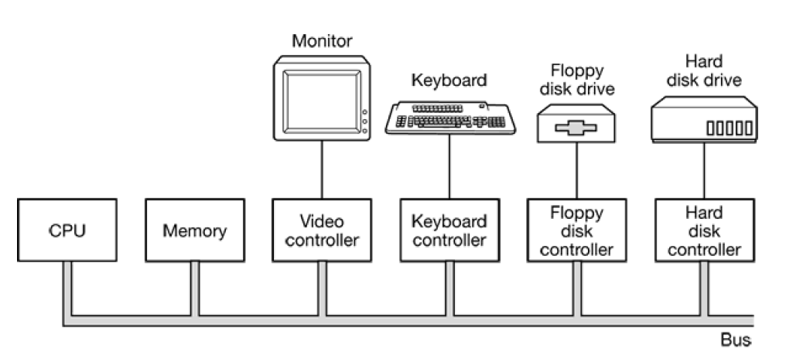
Device Controller

Slide 8
Device Controller
Electronic component which controls the device.
It may handle multiple devices.
There may be more than one controller per mechanical component (example: hard drive).
Controller's tasks are:
It converts serial bit stream to block of bytes
Perform error correction if necessary
Block of bytes is first assembled bit by bit in buffer inside the controller
After verification, the block has been declared to be error free, and then it can be copied to main memory

Slide 9
Device Controller
Each device controller has a few registers that are used for communicating with the CPU.
By writing into these registers, the OS can command the device to deliver data, accept data, switch itself on or off, or perform some action.
By reading from these registers OS can learn what the device’s status is, whether it is prepared to accept a new command and so on.
There are two ways to communicate with control registers and the device buffers:
I/O Port
Memory mapped I/O

Slide 10
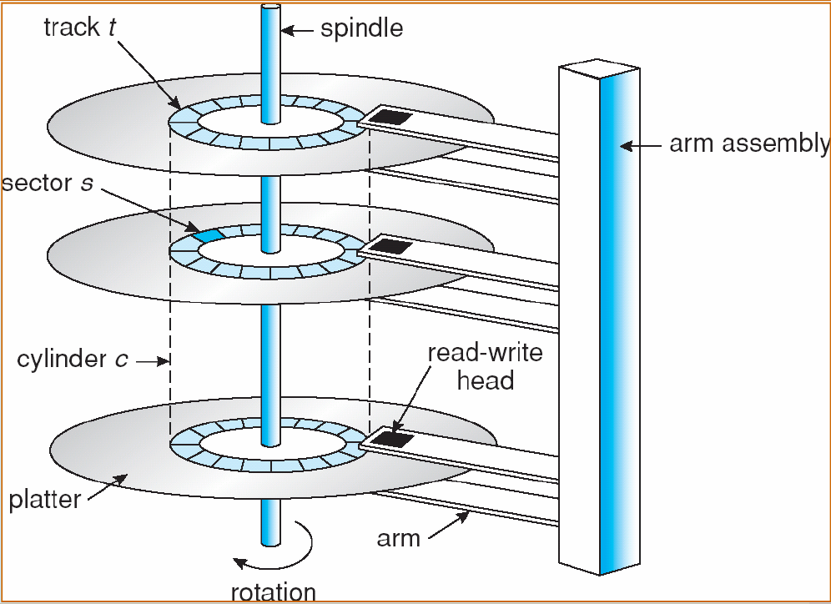
Disk Architecture
Platter → Surface → Track → Sector → Data .
8*2*256*512*512KB
2(3)*2(1)*2(8)*2(9)*2(9)2(10)
2(40)
1TB

Slide 11
Disks
It is relatively permanent and can hold large quantities of data. Its access time is slow compared with that of main memory and magnetic disk. provide the bulk of secondary storage for modern computer system.
disk platter: has a flat circular shape, like a CD. The two surfaces of a platter are covered with a magnetic material. We store information by recording it magnetically on the platters.
The surface of a platter is logically divided into circular tracks which are subdivided into sectors. The set of tracks that are at one arm position makes up a cylinder.

Slide 12
Disk Access time
Seek time – the time taken by r/w head to reach desired track.
Rotation time – the time for one full rotation (360◦).

Slide 13
How does CPU communicate with registers and buffers?
First scheme
If CPU want to read word,
Puts read SIGNAL on control line
Put address on address line
A second signal line is used to tell weather I/O space or memory space is needed.
Memory mapped approach
If CPU want to read word,
Puts read SIGNAL on control line
Put address on address line and let memory module and I/O devices compare address with the ranges they serve.

Slide 14
Memory Mapped I/O
Advantages:
As the I/O space is mapped into memory so no need of any special instructions to read/write control register, can write a device driver in C
Don’t need special protection to keep users from doing I/O directly. Just don’t put I/O memory in any user space.
Disadvantages:
If there is only one address space, then all memory modules and all I/O devices must examine all memory references to see which ones to respond to.
solution: A dual-bus memory

Slide 15
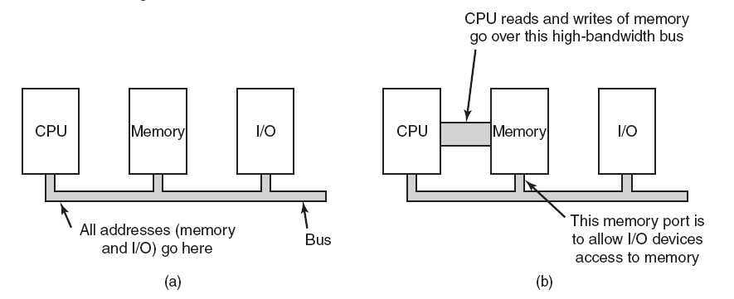
Memory-Mapped I/O
(a) A single-bus architecture. (b) solution: A dual-bus memory architecture.

Slide 16
Direct Memory Access
CPU could request data one byte at a time from I/O controller, Big waste of time. So other schema can be used DMA.
DMA controller can access system bus independent of CPU. DMA contains serval registers that can be written and read by CPU.
Memory address register
Byte count register
Control registers-I/O port, direction of transfer, transfer units (byte/word), number of bytes to transfer in a burst.

Slide 17
How Disk read occurs when DMA is not used??
First the controller reads the block (one or more sectors) from the drive serially, bit by bit, until the entire block is in the controller’s internal buffer.
Next, it computes the checksum to verify that no read errors have occurred. Then the controller causes an interrupt.
When the operating system starts running, it can read the disk block from the controller’s buffer a byte or a word at a time by executing a loop, with each iteration reading one byte or word from a controller device register and storing it in main memory.

Slide 18
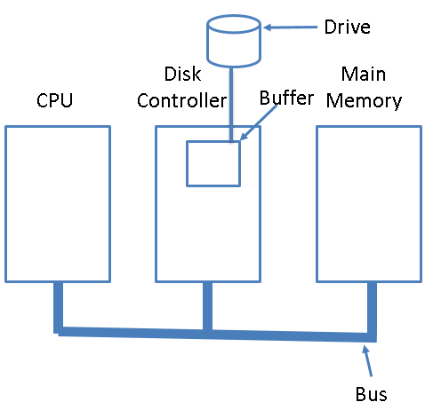
How Disk read occurs when DMA is not used??

Slide 19
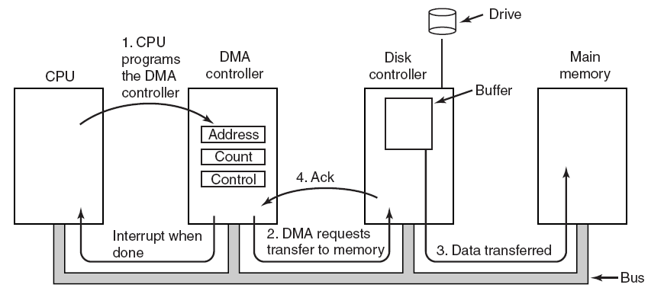
How does DMA work?

Slide 20
How does DMA work?
Step 1: First the CPU programs the DMA controller by setting its registers so it knows what to transfer where.
It also issues a command to the disk controller telling it to read data from the disk into its internal buffer and verify the checksum. When valid data are in the disk controller’s buffer, DMA can begin.
Step 2: The DMA controller initiates the transfer by issuing a read request over the bus to the disk controller.
This read request looks like any other read request, and the disk controller does not know (or care) whether it came from the CPU or from a DMA controller.

Slide 21
How does DMA work?
Typically, the memory address to write to is on the bus’ address lines, so when the disk controller fetches the next word from its internal buffer, it knows where to write it.
Step 3: The write to memory is another standard bus cycle.
Step 4: When the write is complete, the disk controller sends an acknowledgement signal to the DMA controller, also over the bus.
The DMA controller then increments the memory address to use and decrements the byte count.
If the byte count is still greater than 0, steps 2 to 4 are repeated until it reaches 0.

Slide 22
Modes of bus operation
The buses can be operated in two modes
Word-at-a-time mode: Here the DMA requests for the transfer of one word and gets it.
If CPU wants the bus at same time then it has to wait.
This mechanism is known as Cycle.
Block mode: Here the DMA controller tells the device to acquire the bus, issues a series of transfer and then releases the bus.
This form of the operation is called Burst mode.
It is more efficient then cycle stealing.

Slide 23
Disk Arm Scheduling Algorithm
Various types of disk arm scheduling algorithms are available to decrease mean seek time.
FCFS (First come first serve)
SSTF (Shorted seek time first)
SCAN
C-SCAN
LOOK (Elevator)
C-LOOK

Slide 24
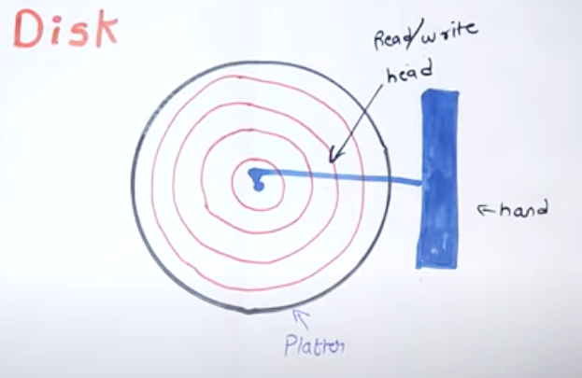

Slide 25
FCSC (First come first serve)
Here requests are served in the order of their arrival.
Disk movement will be 11, 1, 36, 16, 34, 9 and 12.
Total cylinder movement: (11-1) + (36-1) + (36-16) + (34-16) + (34-9) + (12-9) = 111
0
1
9
12
16
34
36
50
11
1, 36, 16, 34, 9, 12
1
36
16
34
9
12

Slide 26
Disk Scheduling Algorithm
Q1 Track no given= 82, 170,43,140,24,16,190
A disk contains 0-199 tracks
Current position of r/w head is 50
Calculate the total no of track movement of your r/w head?
Solution-
FCFS= and SSTF=
SCAN=
C-SCAN
LOOK
C-LOOK

Slide 27
SSTF (Shortest seek time first)
We can minimize the disk movement by serving the request closest to the current position of the head.
Disk movement will be 11, 12, 9, 16, 1, 34, 36.
Total cylinder movement: (12-11) + (12-9) + (16-9) + (16-1) + (34-1) + (36-34) = 61
0
1
9
12
16
34
36
50
11
1, 36, 16, 34, 9, 12
12
9
16
1
34
36

Slide 28
LOOK(Elevator)
Keep moving in the same direction until there are no more outstanding requests pending in that direction, then algorithm switches the direction.
After switching the direction the arm will move to handle any request on the way. Here first go it moves in up direction then goes in down direction.
This is also called as elevator algorithm.
In the elevator algorithm, the software maintains 1 bit: the current direction bit, which takes the value either UP or DOWN.

Slide 29
LOOK (Elevator)
Disk movement will be 11, 12, 16, 34, 36, 9, 1.
Total cylinder movement: (12-11) + (16-12) + (34-16) + (36-34) + (36-9) + (9-1)=60
0
1
9
12
16
34
36
50
11
1, 36, 16, 34, 9, 12
12
16
34
36
9
1

Slide 30
Disk Scheduling Algorithm
Q1 Track no given= 82, 170,43,140,24,16,190
A disk contains 0-199 tracks
Current position of r/w head is 50 direction is towards larger value of track
Calculate the total no of track movement of your r/w head?
Solution-
FCFS=642 and SSTF=208
SCAN=
C-SCAN
LOOK
C-LOOK

Slide 31
C-LOOK
Keep moving in the same direction until there are no more outstanding requests pending in that direction, then algorithm switches direction.
When switching occurs the arm goes to the lowest numbered cylinder with pending requests and from there it continues moving in upward direction again.

Slide 32
C-LOOK
Disk movement will be 11, 12, 16, 34, 36, 1, 9.
Total cylinder movement: (12-11) + (16-12) + (34-16) + (36-34) +(36-1)+(9-1)=68
0
1
9
12
16
34
36
50
11
1, 36, 16, 34, 9, 12
12
16
34
36
1
9

Slide 33
SCAN
From the current position disk arm starts in up direction and moves towards the end, serving all the pending requests until end.
At that end arm direction is reversed (down) and moves towards the other end serving the pending requests on the way.

Slide 34
SCAN
Disk movement will be 11, 12, 16, 34, 36, 50, 9, 1.
Total cylinder movement: (12-11) + (16-12) + (34-16) +(36-34) +(50-36) + (50-9) + (9-1) = 88
0
1
9
12
16
34
36
50
11
1, 36, 16, 34, 9, 12
12
16
34
36
9
50
1

Slide 35
C-SCAN
From the current position disk arm starts in up direction and moves towards the end, serving request until end.
At the end the arm direction is reversed (down), and arm directly goes to other end and again continues moving in upward direction.

Slide 36
C-SCAN
Disk movement will be 11, 12, 16, 34, 36, 50, 0, 1,9.
Total cylinder movement: (12-11) + (16-12) + (34-16) +(36-34) +(50-36) + (50-0) + (1-0)+ (9-1) = 98
0
1
9
12
16
34
36
50
11
1, 36, 16, 34, 9, 12
12
16
34
36
0
50
1
9

Slide 37
Disk Scheduling Algorithm
Q- Track no given= 55,58,39,18,90,160,150,38,184
A disk contains 0-199 tracks
Current position of r/w head is 100 and direction is towards larger value of track
Calculate the total no of track movement of your r/w head for FCFS, SSTF, SCAN,C-SCAN, LOOK AND C-LOOK?

Slide 38
Disk Scheduling Algorithm
Solution
FCFS=498
SSTF=248
SCAN= 280
C-SCAN=388
LOOK=250
C-LOOK=322

Slide 39


